Slide 1
Useful Expressions
Basic 01

Slide 2

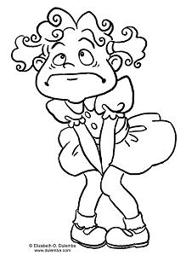
Important Phrases to remember
Blah blah blah …☺
No Spanish.. ☺
Teacher..ya no aguanto…. ☹
Profe…Baño…

Slide 3
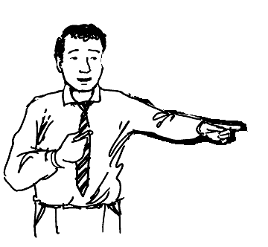
Correct way to ask…
Sure ☺
Yes ?
May I go to the restroom, please ?
Excuse me, teacher.

Slide 4
May I go to the bathroom / restroom?
Podria ir al baño, por favor?
What does _eraser_ mean?
Que significa_eraser?
How do you say _carpeta_ in English?
Como se dice_carpeta_ en Ingles?
How do you spell desk?
Como se escribe desk?

Slide 5
How do you pronounce this ?
Como se pronuncia esto?
Can you repeat that, please?
Podria repetirlo, por favor?
Can you lend me an eraser?
Me puedes/podrias prestar un borrador?
What do we have to do?
Que tenemos que hacer? (Exercise)

